Slide 1









Stay connected
orbit.au.dk
(newsletter) orbit.au.dk
facebook.com/orbitlab.dk
orbit_lab
linkedin.com/company/orbitlab
Se footer på website

Slide 2

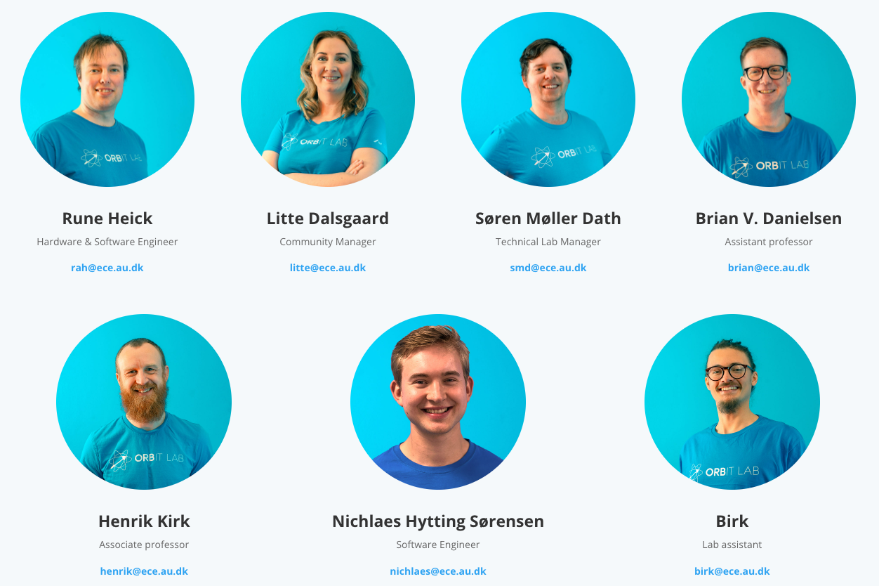
MEET THE TEAM

Slide 3

You Are Here

Slide 4

The Black Window
Master The Command Line
https://github.com/ORBIT-Lab/hack-black-window

Slide 5


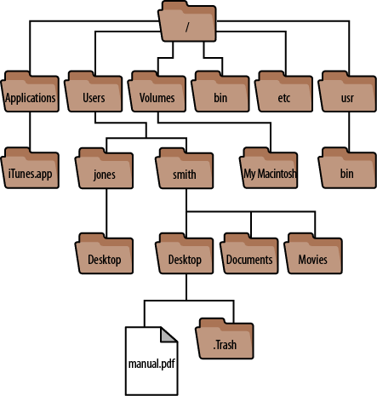
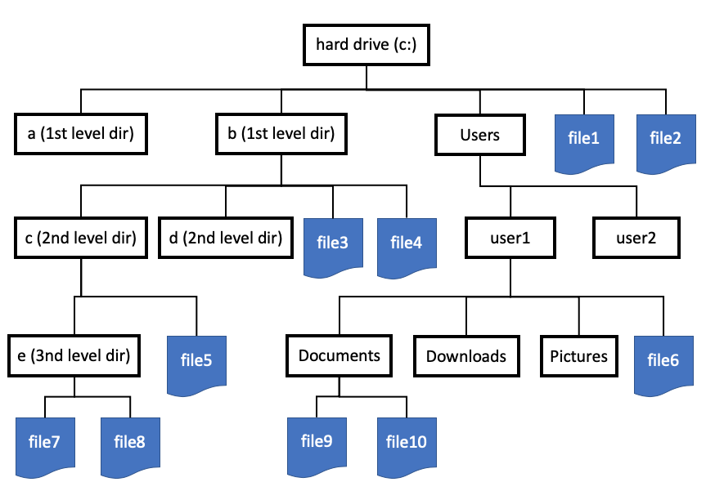
Files Grows on Trees
Windows
Home

Slide 6


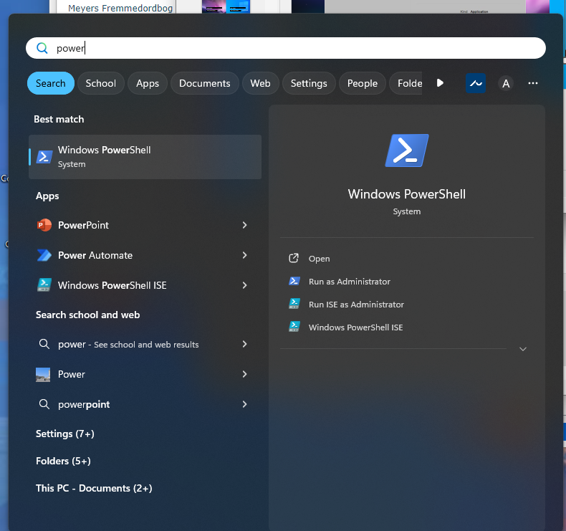
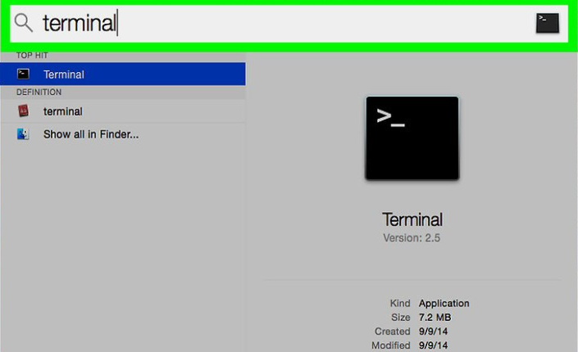
Task 1: Open The Terminal

Slide 7
PATH’s (To Happiness)
Default Relative Path
Default Relative Path
[some]/[folder]/[structure]/[file].[ext]
[some]\[folder]\[structure]\[file].[ext]
Absolute Path
Absolute Path
/[some]/[folder]/[structure]/[file].[ext]
C:\[some]\[folder]\[structure]\[file].[ext]
Relative Path
./[folder]/[structure]/[file].[ext]
Relative Path
Relative To Home Path
.\[folder]\[structure]\[file].[ext]
~/[folder]/[structure]/[file].[ext]
Relative with ..
Relative with ..
./[folder]/../[folder]/./[file]
[folder]/[file]
.\[folder]\..\[folder]\.\[file]
[folder]\[file]

Slide 8

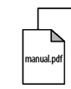
Paths
Absolute Path
Absolute Path
/Users/smith/Desktop/manual.pdf
C:\Users\user1\Documents\manual.pdf
Relative Path
Relative Path
../../smith/Desktop/manual.pdf
..\Documents\manual.pdf

Slide 9
List File at current Location
ls
dir
ls [path]
dir [path]

Slide 10
Create Folder
mkdir [folder]
mkdir [folder]
mkdir [folder]/[folder]
Folder structure
mkdir [folder]\[folder]
Folder structure

Slide 11
Task 3: Change current Location
cd [path]
Relative to current location
E.g.:
cd ..
Jump out of folder
cd ./ [name of the folder]
Relative to current location
cd [folder]/[folder]
Jump relative into subfolder
D:/
Change Harddisk

Slide 12
Copy File
cp [source path] [destination path]
copy [source path] [destination path]

Slide 13
Move File/Folder
mv [source path] [destination path]
move [source path] [destination path]

Slide 14
Remove File/Folder
rm [file]
del [folder/file]
rm -r [folder]

Slide 15
Print out Content of File
cat [path]
type [path]

Slide 16
Exercise:
Download and unzip the “file-maze” from: https://github.com/ORBIT-Lab/hack-black-window
Use the learned commands to find the items in the maze and transfer/copy them to your house.
0. Create a folder named “house”, this is your house and should not be moved. It can be placed anywhere you like.
Gold should be “moved” to your house.
Art should be “copied” to your house.
Any trash should be “deleted” to leave the maze clean
(“cat/type” the files named item-[number].txt to see what they are)
Printout content of found files to see what they are.

Slide 17
Commands in the terminal is just programs!
command
Argument List
cp [source path] [destination path]
Program Name
Argument 1
Argument 2

Slide 18
Run Program
./[path to program]
[path to program].exe
If spaces in path use the “
If spaces in path use the “
“./[path to program]”
“[path to program].exe”
/System/Applications/TextEdit.app/Contents/MacOS/TextEdit
C:\Windows\System32\notepad.exe

Slide 19
The Path Environment Variable
command
Argument List
cp [source path] [destination path]
How does it know where to find the CP program

Slide 20
Path Variables In Terminal
List:
List:
echo $PATH
echo %PATH%
Add for current terminal Only:
Add for current terminal Only:
export PATH="/your/path/here:$PATH"
set PATH=%PATH%;C:\your\path\here\

Slide 21
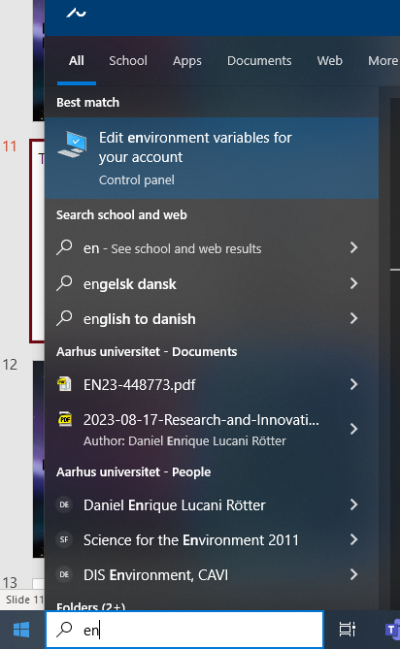
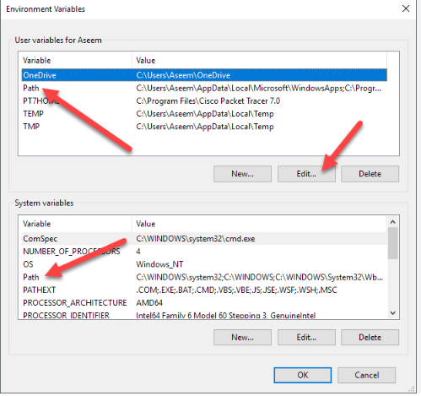
The PATH - Environment Variable – Permanent Set
Create or append to the file:
~/.bash_profile
With the previously command:
export PATH="/your/path/here:$PATH"
”miljøvariabler” in danish

Slide 22
Add a Program to Path:
Select a program that you would like to be able to open from a terminal easily. Like “chrome”
0. Find where it is located on the disk, (you can google if you have no idea where to look)
Add the path to the PATH environment variable
Open a terminal and type the name of the program

Slide 23
